Slide 1
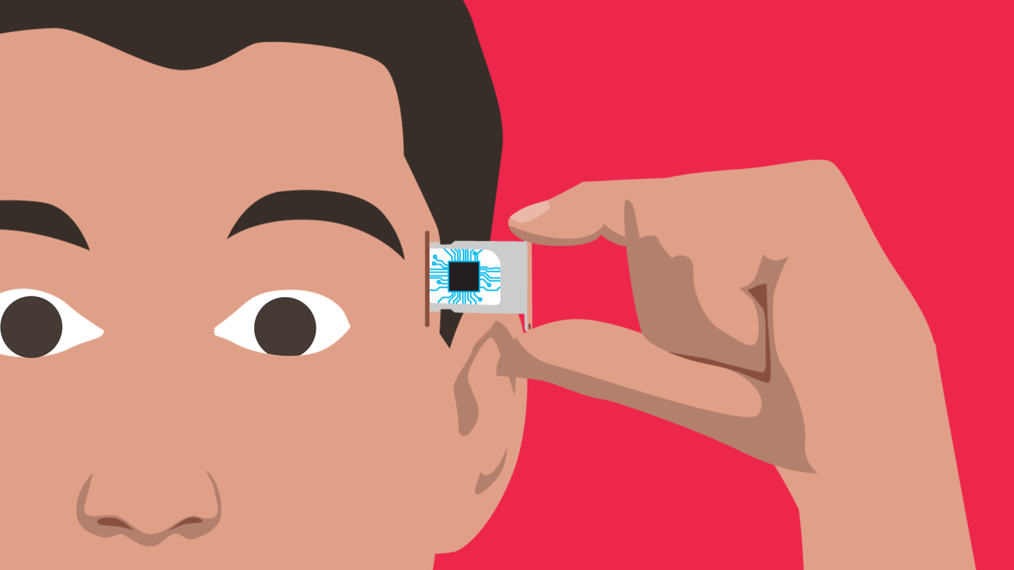
Hardware Accelerated SSVEP based Brain to Computer Interface
Luke Slemon - 16421694

Slide 2
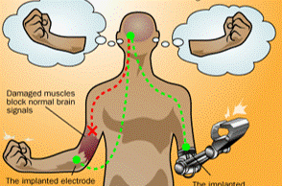
Brain to Computer Interface (BCI)
Control systems for external devices or applications using patients Brain activity.
Oscillatory activity caused by evoked or spontaneous potentials.
Evoked – Potentials caused by an external stimulus, i.e. flashing visual stimuli
Spontaneous – Natural occurring signals caused by the patient’s own will, i.e. Motor rhythms occurring during body motion.
Utilising signal processing and classification methods, it is possible to decode these signals and utilise them to control systems, or replicate basic limb movement.

Slide 3

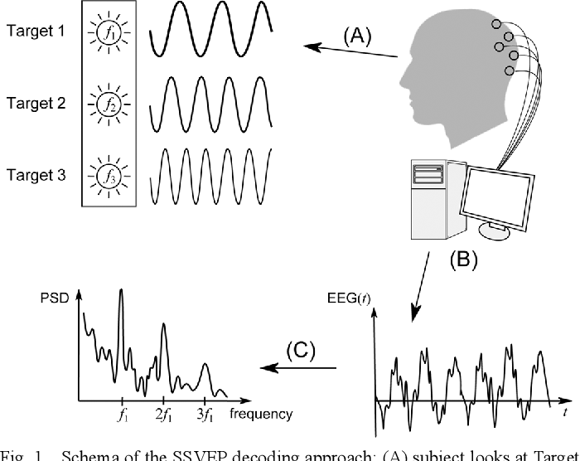
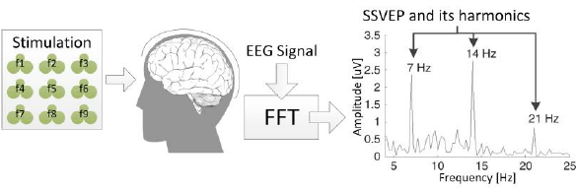
Steady State Visually Evoked Potentials (SSVEP)
Oscillatory activity in the occipital cortex of the brain.
Evoked by focusing on a single flashing stimulus.
The simplest BCI to implement because of its ease of detection.
Requires very little processing.
Features for classification extracted as band powers surrounding the frequencies of the stimuli.
Control signals encoded as each frequency.
Wheelchair example encoding, 6Hz could be move forward.

Slide 4
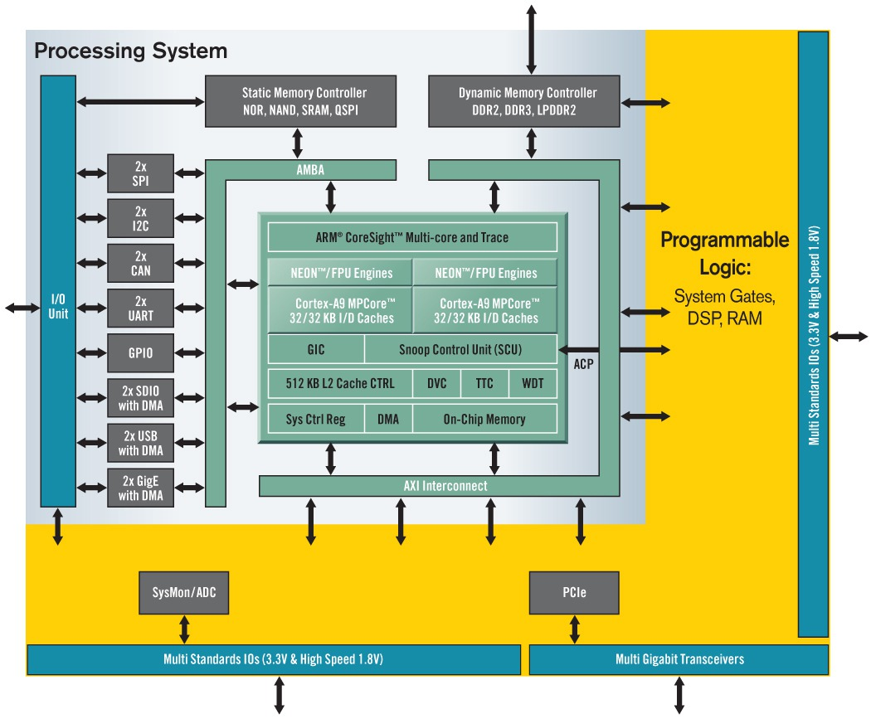
ZYNQ-7000
All in one System on Chip (SoC)
Coupling a Processing System(PS) with Programmable Logic(PL).
Utilised for greater flexibility in projects.
PS running Ubuntu distribution of Linux.
Collection of external interfaces and drivers.
Industry standard AXI interface.
AXI4 High perf mem mapped transfers
AXI4-Lite Single burst mem mapped transfers
AXI4-Stream High speed data transfers.

Slide 5
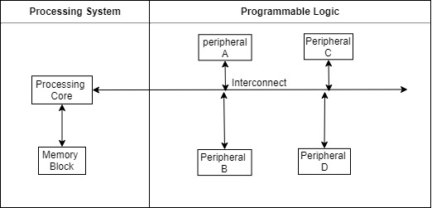
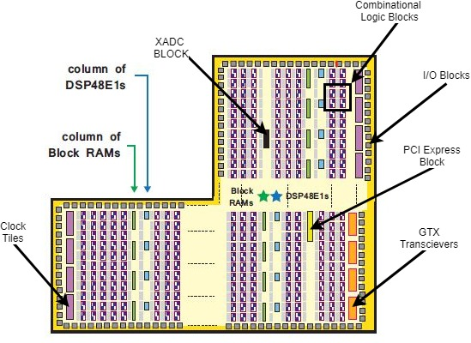
ZYNQ Programmable Logic (PL)
PL based on 7-Series Xilinx FPGA
SoC peripherals are developed in PL.
All peripherals are interfaced using a bus or interconnect
PL is comprised of LUTs, DSP48s and BRAMs.
LUTs used for implementing logic circuitry.
DSP48s used for performing high speed arithmetic.
BRAMs used for on-board storage of data. Allows for faster data transfers than accessing DDR.

Slide 6
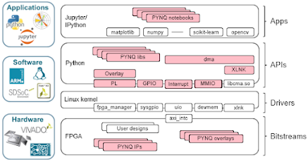
Python productivity for ZYNQ (PYNQ)
Combines productivity of Python with acceleration provided by PL.
Helps abstract the lower level drivers by using Python.
Use on board web-server for browser based IDE.
Linux image handles PS configurations and memory handling. Further abstracting lower level functionality.

Slide 7
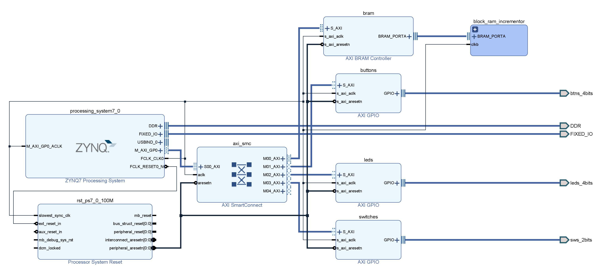
Overlay
Hardware designs created in Vivado.
Overlay Object created using generated TCL and Bit files.
Allow developers to access AXI hardware components as python modules.
Python drivers can be created for the hardware comps.

Slide 8
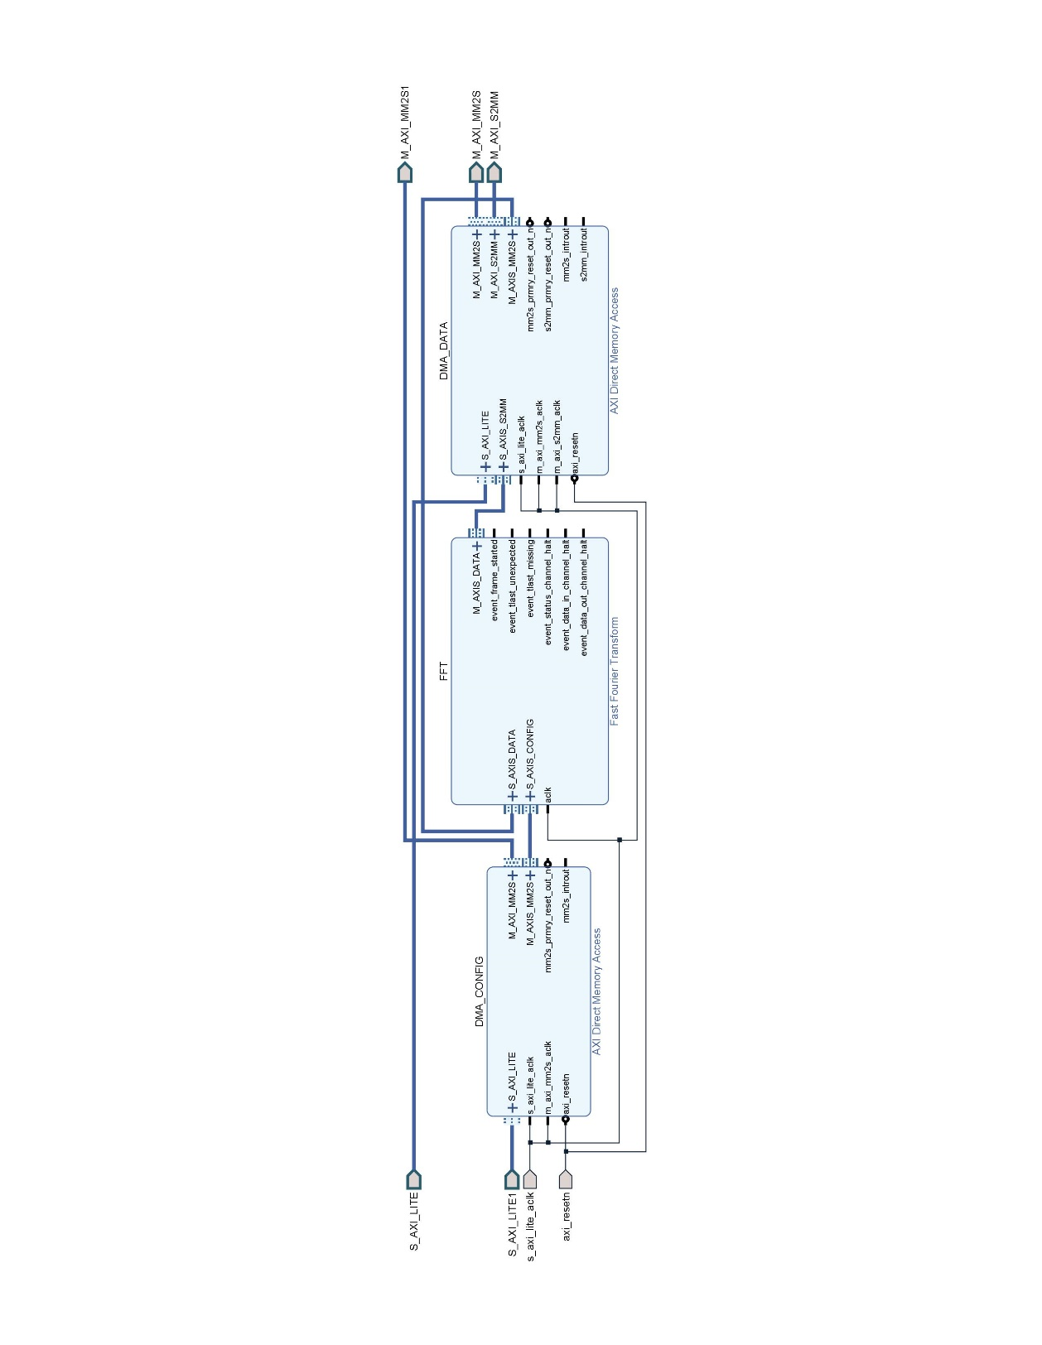
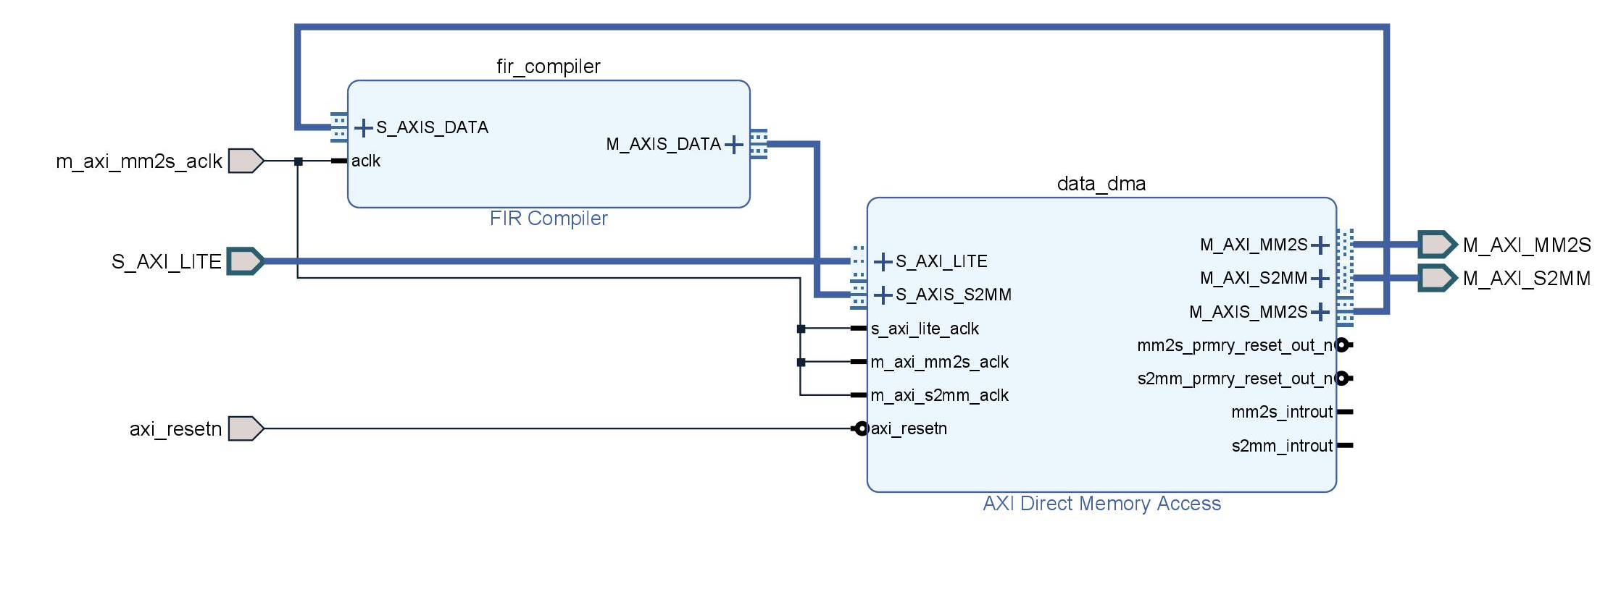
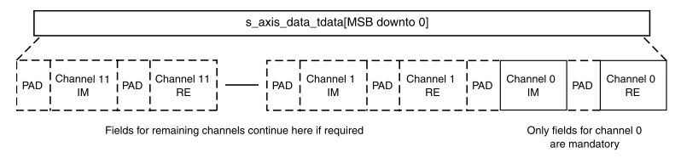
Hardware Progress
FIR Filter
Implemented using a DMA.
Contiguous buffers allocated using Xlnk Module, physical address of data in DRAM sent to DMA.
DMA reads the data and passes it to the FIR filter in a stream.
Output data is returned to the DMA and passed to a new contiguous buffer.
FFT core
Implemented using 2 DMAs, one for data, one for configuration.
Core allows more than one channel to be processed at once.
Complex numbers are handled by creating an output buffer twice the length of the input buffer.

Slide 9
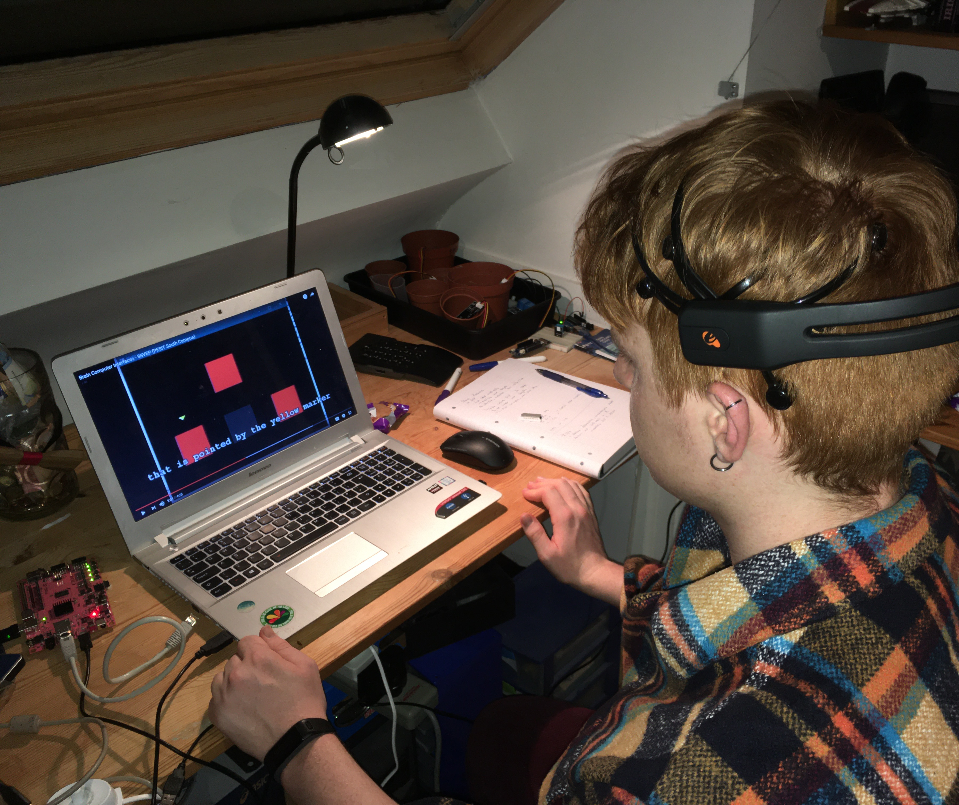
Data Acquisition
Data will be recorded using an Emotiv Epoc headset.
A community developed library for Linux to use python to access the raw data.
Data is read from the USB port and decoded.

Slide 10
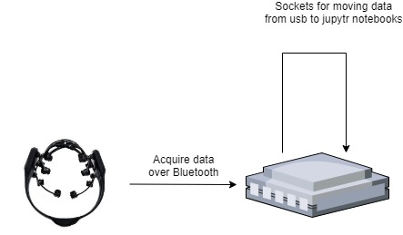
Communication
EEG acquisition scripts are written in Python 2.
Jupytr Notebooks uses Python 3.
Socket communications used to retrieve data from EEG.
Sampling rate at 128 samples second, data passed between scripts 4 channels at a time.

Slide 11
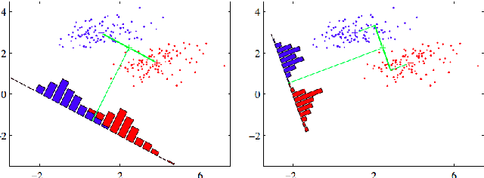
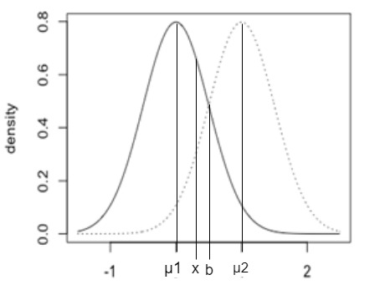
Linear Discriminant Analysis (LDA)
Probabilistic machine learning model.
Used in BCI applications because of its low computational complexity.
Primary task is to classify input data based on the probability it belongs to a certain class.

Slide 12
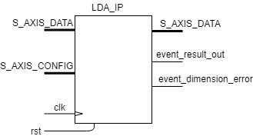
LDA Hardware implementation
Work similar to FFT core.
Perform offline analysis and model generation on Jupytr notebooks.
Pass created covariance matrices and mean vectors to hardware using CONFIG port.
DATA port will read feature vector and make predictions on the data.

Slide 13
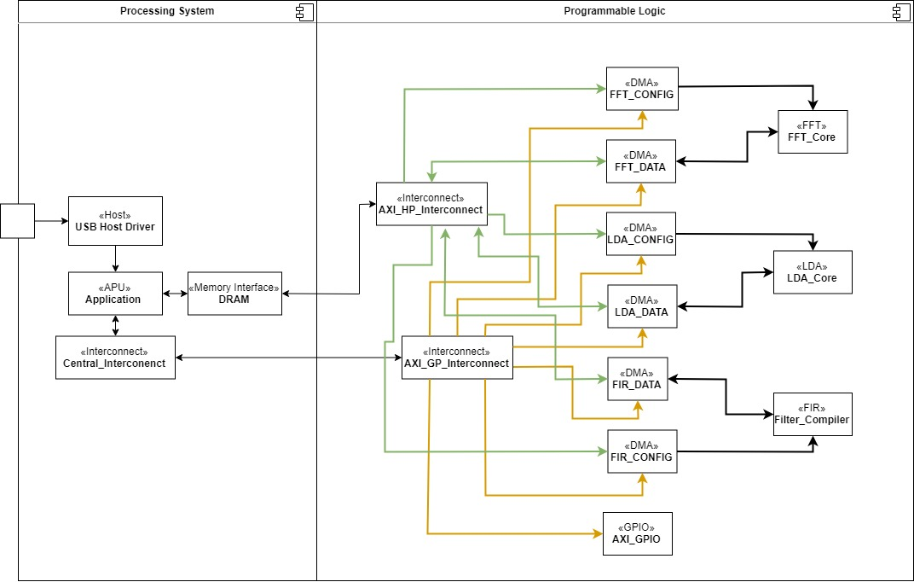
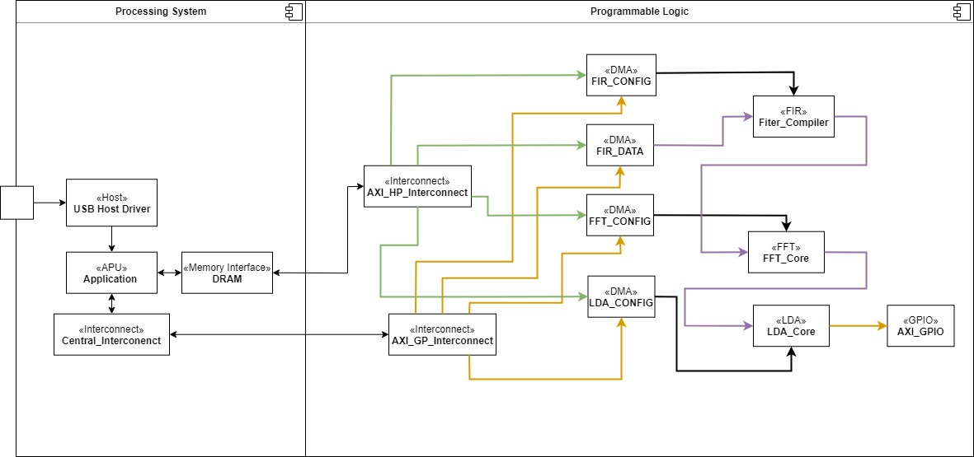
Potential finished schematics

Slide 14
The End
Any Questions?

